Slide 1
Lunar Eclipse

Slide 2
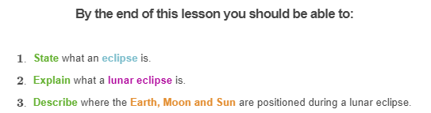
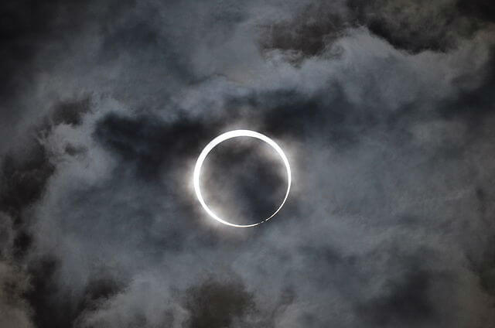

Slide 3
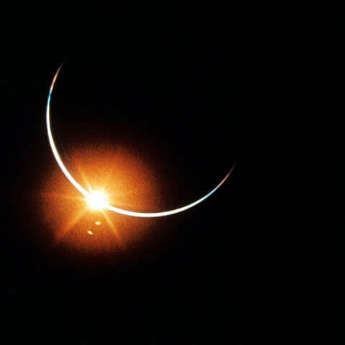
An eclipse is an astronomical event.
It occurs when one object in the sky moves into the shadow of another such object.
Have you ever seen an eclipse take place?

Slide 4
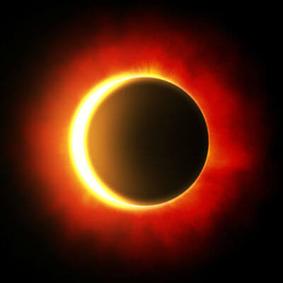
Any object that can't be seen through casts a shadow when the Sun shines on it.
The Earth and Moon both cast shadows into space because the Sun shines on them.
An eclipse is an event that occurs when one celestial body (e.g. the Moon) moves into the shadow of another celestial body (e.g. the Earth).

Slide 5
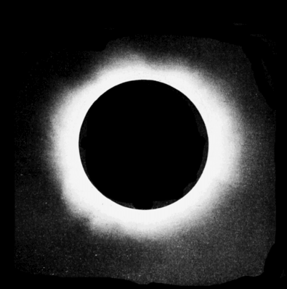
When the Moon passes between the Earth and the Sun, the Moon's shadow falls on the Earth.
If this happens during the day, the part of the Earth in the Moon's shadow experiences a solar eclipse.
The name of the eclipse tells you which object is getting darker. A solar eclipse means the Sun (Sol) is getting darker.

Slide 6
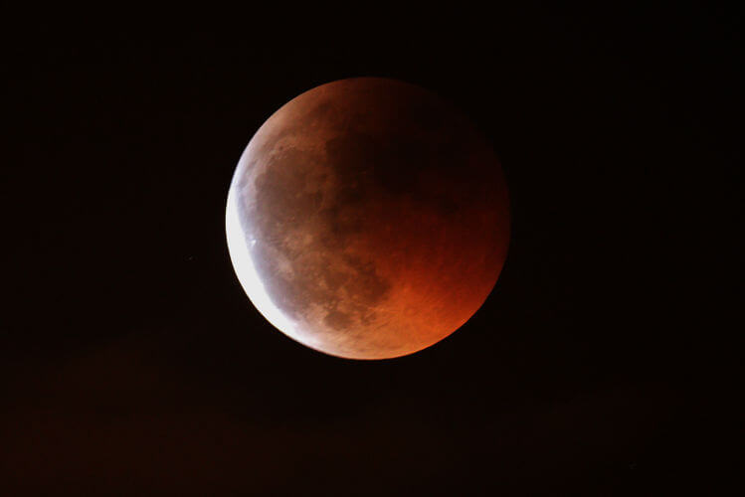
When the Earth passes between the Moon and the Sun, the Earth's shadow falls on the Moon.
The side of the Earth in darkness experiences a lunar eclipse.
Remember, the name of the eclipse tells you which object is getting darker. A lunar eclipse means the Moon (Luna) is getting darker.

Slide 7
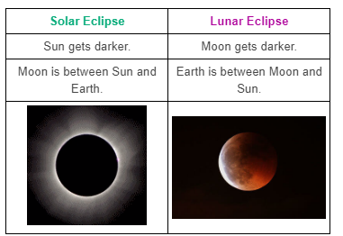
The name of the eclipse tells you which object is getting darker.

Slide 8
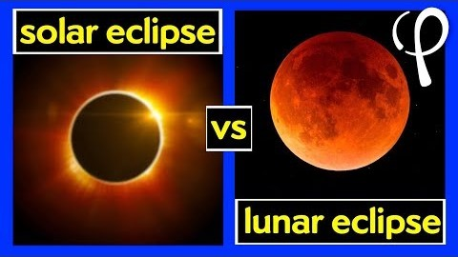

Slide 9
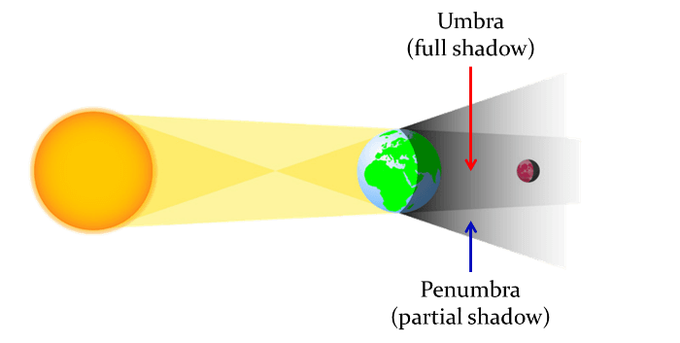
The umbra and penumbra are different parts of a shadow.
Both the Earth's and Moon's shadows have both an umbra and penumbra.
Umbra means "shadow" in Latin. This is the darkest part of the shadow, where the light is completely blocked.
Penumbra means "almost shadow" in Latin. This is the part of the shadow where only part of the light is blocked.

Slide 10
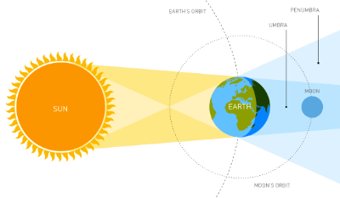
A lunar eclipse occurs when the Moon passes directly behind the Earth into its shadow.
This makes the Moon appear darker.

Slide 11
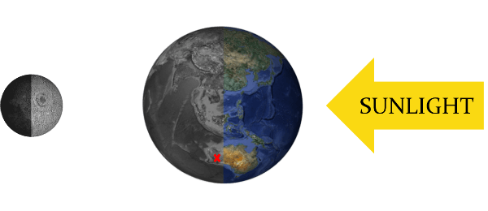
A lunar eclipse can occur only when the Sun, Earth and Moon are aligned exactly, with the Earth in the middle.
This means a lunar eclipse can only occur on the night of a full moon, because full moons occur when the Moon is directly behind the Earth.

Slide 12
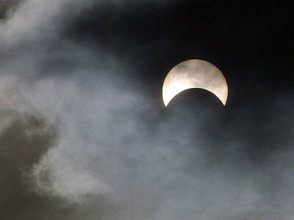
There are two different types of lunar eclipse.
A partial lunar eclipse occurs when the umbra of the Earth's shadow only partially covers the Moon. This is not the same as a moon phase, because the Moon is still a full moon. The shadow passes over the Moon within just a few hours.

Slide 13
A total lunar eclipse occurs when the umbra of the Earth's shadow completely covers the Moon.
The Moon appears red during a total lunar eclipse.
The Moon doesn't just disappear all of a sudden during a total lunar eclipse, because of the penumbra and the umbra. As the Moon passes through the penumbra of the Earth's shadow it darkens. When the Moon passes through the umbra of the Earth's shadow it turns red.

Slide 14
You may be wondering why the Moon turns red when it passes through the umbra of Earth's shadow.
The answer lies in the Earth's atmosphere.
The atmosphere acts like a filtered lens. It bends red sunlight into our planet's shadow and scatters out blue light. It's the same reason why sunrises and sunsets appear reddish.

Slide 15
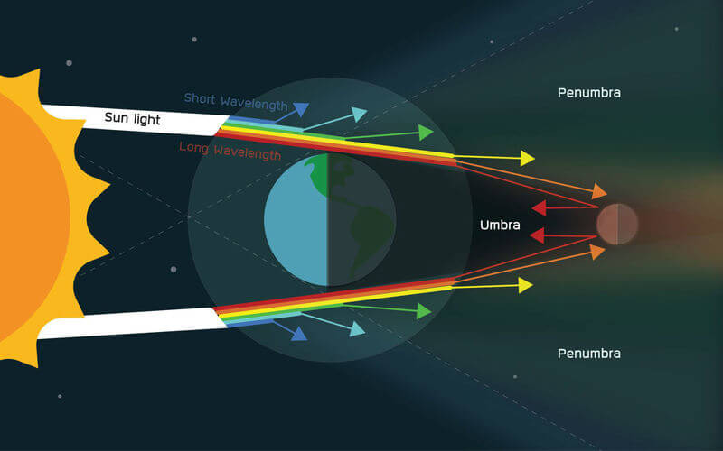

Slide 16
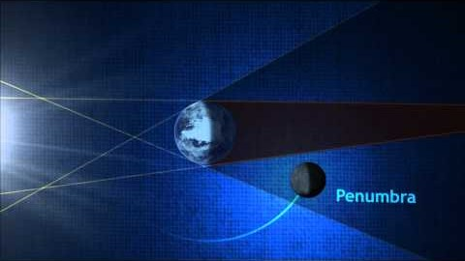

Slide 17
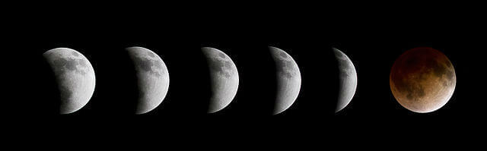
Lunar eclipses do not occur every time there is a full moon.
This is because the Moon is tilted on its axis so it doesn't pass through the Earth's shadow in every orbit.

Slide 18
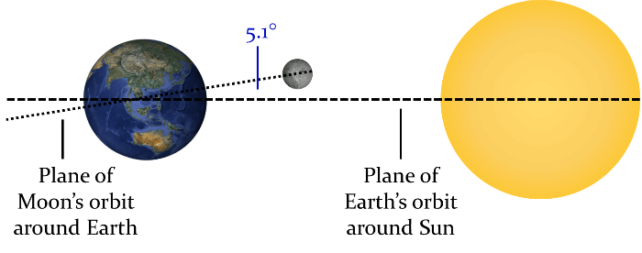
The Moon's orbit around Earth is on an angle compared to Earth's orbit.
The plane of the Moon's orbit around the Earth is tilted on an angle of 5.1∘ compared to the plane of the Earth's orbit around the Sun.
This means that the Moon only passes directly between the Earth and the Sun occasionally, about two to four times per year.

